Slide 1
1. Course Introduction
Youngsoo Kim <pineland@hanmail.net>
Code : https://github.com/pineland/AIDA/

Slide 2
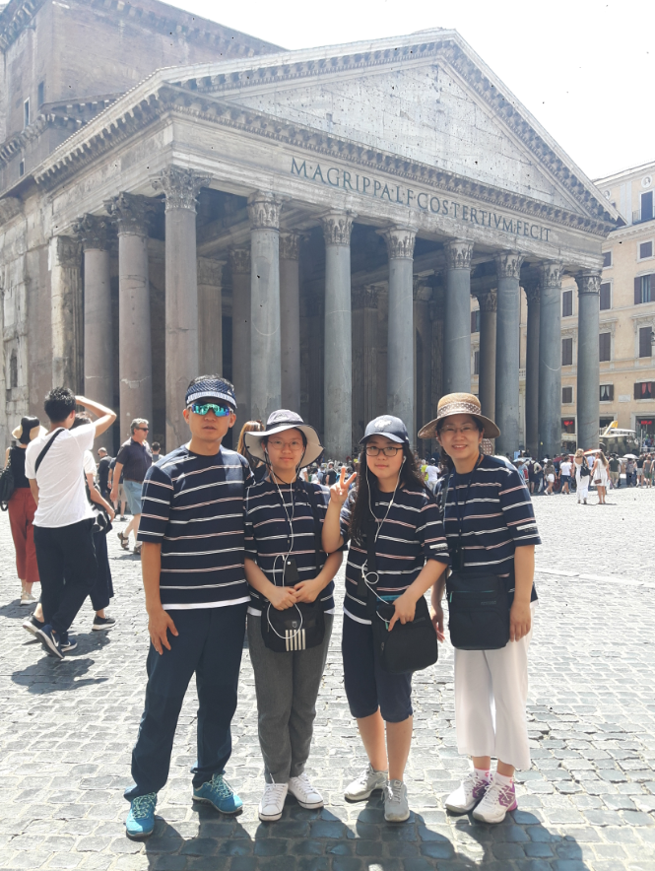
Who am I?
김영수(공군중령, 49세)
병과 : 정보통신
학력
1994. 3 : 공사 전산과학과 이학사
2001. 2 : 서강대학교 컴퓨터공학 석사
2009. 2 : 한국과학기술원 전산학 박사
주요보직
2018 ~ : 공사 교수부 전산학과 교관
2017 : 군수사령부 전산소장
2016 : 공본 정보화기획참모부 정보체계관리과장
2014 ~15 : 공사 생도대 생도2대대장
2013 : 제7항공통신전대 전술이동통신대대장
2012 : 제29전술비행전대 공중전투훈련장운영대대장
2011 : 공군본부 정보화부 정보화소요담당
연락처 : pineland@hanmail.net, 010-5088-0507

Slide 3

My personality
꼼꼼해~@.@;;;
컴퓨터가 나를 이렇게 만드러쓔~^^;
“열정”이 있는 사람이 좋아요~♡♡♡
가슴 떨리는 말…
“조국”, “군인“, “명예”, “정의”, “진리”, …
욕심이 지나친 경우가 많다!ㅠ.ㅠ

Slide 4
Goals of this class
Understand machine learning (ML) and deep learning (DL) for data science
KNN, Random Forest, SVM, etc.
Neural Networks, Convolutional Neural Network, Recurrent Neural Network
Solve your domain problems of data science using ML/DL learning tools
Python, Scikit-learn and TensorFlow
(Big) structured data analysis, unstructured data(long text, image, sound) processing, etc

Slide 5
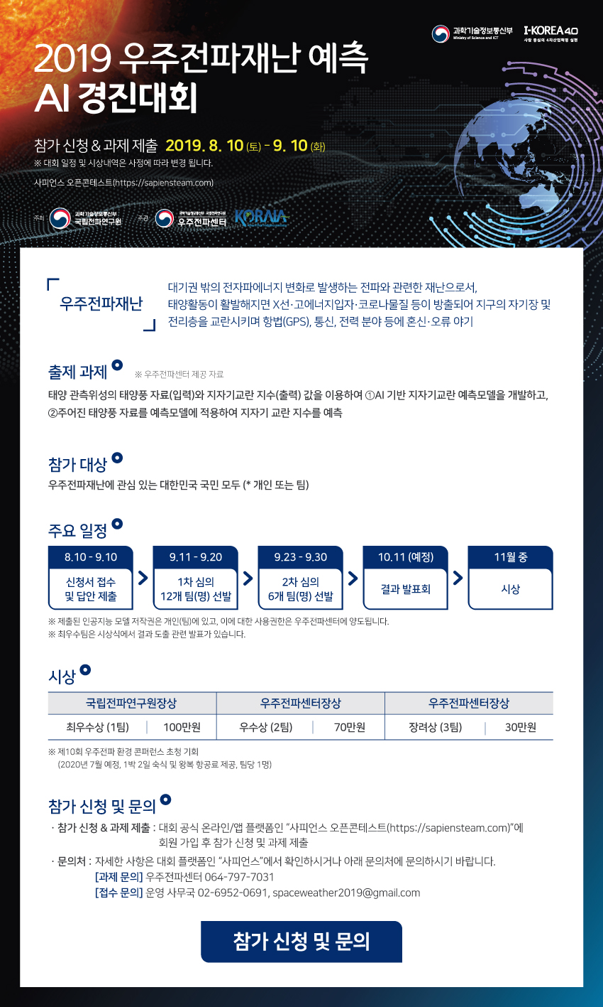

Slide 6

Schedule
AI & Data science basic concepts
Machine learning algorithms theory for data science & implementation
KNN, Decision tree, Random forest, SVM, etc
Implement with Scikit-learn
Deep learning algorithms theory for data science & implementation
ANN, CNN, RNN, and so on
Implement with TensorFlow
"Theory and implementation"

Slide 7
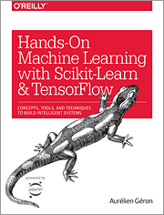
Textbook
Textbook
Hands-On Machine Learning with
Scikit-learn and Tensorflow, Aurélien
Géron 著, O'Reilly, 2017
References
Python for Data Analysis, Mckinney, Wes 著, O'Reilly, 2019
Introduction to Machine Learning with Python, Andreas C. Muller & Sarah Guido 著, O'Reilly, 2019
Deep Learning from Scratch, 사이토 고키 著, 한빛미디어, 2019 (번역서)
Feature Engineering for Machine Learning, Alice Zheng and Amanda Casari 著, O'Reilly, 2018
…

Slide 8
Acknowledgement
Andrew Ng’s ML class
https://class.coursera.org/ml-003/lecture
http://www.holehouse.org/mlclass/(note)
Prof. Sunghun Kim's DL lecture
https://hunkim.github.io/ml/
Udacity deep learning
www.udacity.com/course/deep-learning-ud730
Mathematical monk machine learning
www.youtube.com/watch?v=yDLKJtOVx5c&list=PL82A0F00F6B3DEDBC

Slide 9
Assessment
Midterm : 30 %
Final exam : 30 %
Term project : 30 %
Frequent evaluation : 10 %
Attendance
Quiz
Attitude
“최종 확정되는 대로 공지 예정”

Slide 10
On what level should the classes be focused?
Student’s AI/ML/DL/DS study & experience?
when, which task, which role
Student’s programming skill?
skilled / intermediate / beginner
other programming experience
Characteristics of students' academic environment?
military unit (department), position, age, etc.

Slide 11

Q & A

